Slide 1
ARDUINO BASED military fighting robot
BATCH NO: 5
PRESENTED BY
M.SOWMYA (15J41A0496)
J. MANIDEEP NETHA (15J41A0482)
CH. HARSHITH SAI (15J41A0468)
PROJECT GUIDE
Mr.N.PANDURANGA REDDY
Assoc.Professor

Slide 2
CONTENTS
Introduction
Hardware & Software Specifications
Block Diagram
Circuit Diagram
Each Block Description
Applications
Advantages
Result
Conclusion
10. Future Scope

Slide 3
1. INTRODUCTION TO PROJECT
Although there are many command controlled robots, the need for self-controlled robots are on rise for military purposes, which in general called as Unmanned ground vehicles (UGVs).
In this mode, UGV is maneuvered automatically and it capable of travelling from one point to another point without human navigation commands.

Slide 4
2. Hardware & Software Specifications
Hardware Specifications:
Arduino
IR Sensor
Gas sensor
Proximity sensor
Lcd display
Buzzer
LASER light
L293D motor driver
Motors
Software Specifications:
Proteus software
Language: Embedded c
Arduino 1.8.7 IDE

Slide 5
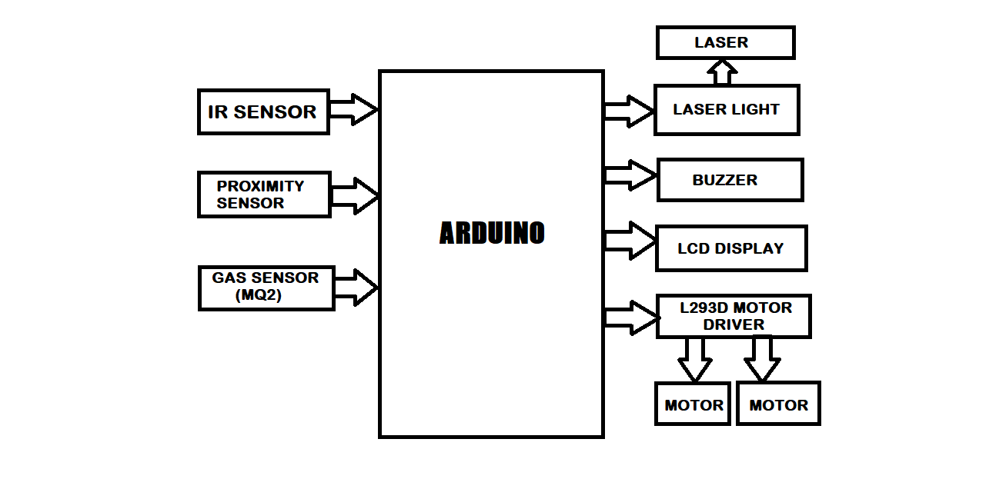
3.BLOCK DIAGRAM

Slide 6
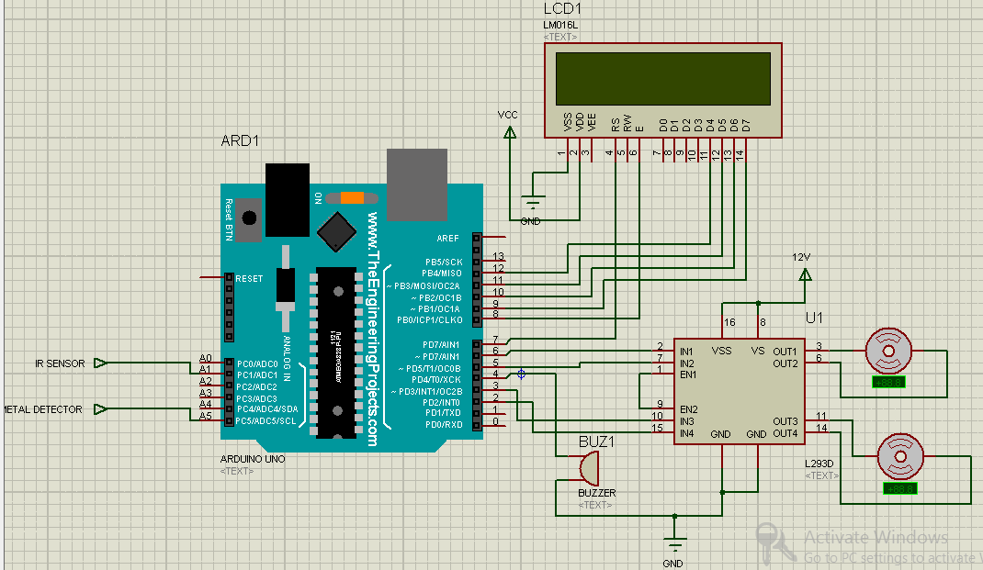
4.CIRCUIT DIAGRAM

Slide 7
1.ARDUINO
5. EACH BLOCK DESCRIPTION
The Arduino Uno is a microcontroller board based on the ATmega328 (datasheet). It has 14 digital input/output pins ,6 analog inputs, a 16 MHz crystal oscillator, a USB connection, a power jack, an ICSP header, and a reset button. It contains everything needed to support the microcontroller; simply connect it to a computer with a USB cable or power it with a AC-to-DC adapter or battery to get started.

Slide 8
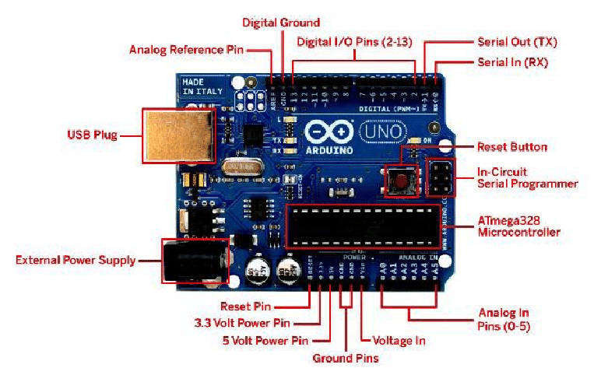
PIN OUT OF ARDUINO

Slide 9
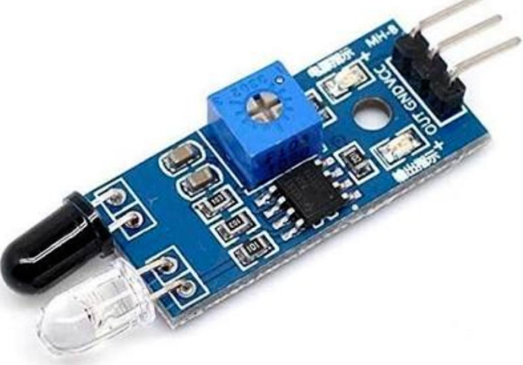
2.IR SENSOR
An infrared sensor is an electronic device, that emits in order to sense some aspects of the surroundings.
An IR sensor can measure the heat of an object as well as detects the motion.
These types of sensors measures only infrared radiation, rather than emitting it that is called as a passive IR sensor.

Slide 10
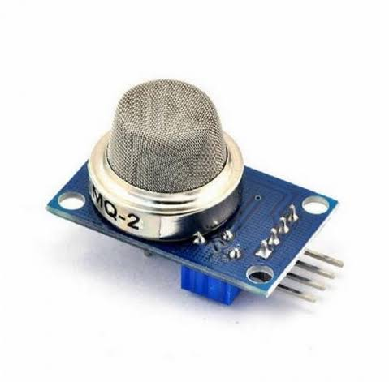
3.GAS SENSOR
Operating voltage is 5v.
It is used to measure or detect LPG, alcohol, propane, hydrogen, co and even methane .
The sensitivity of digital pin can be varied using the potentiometer.

Slide 11
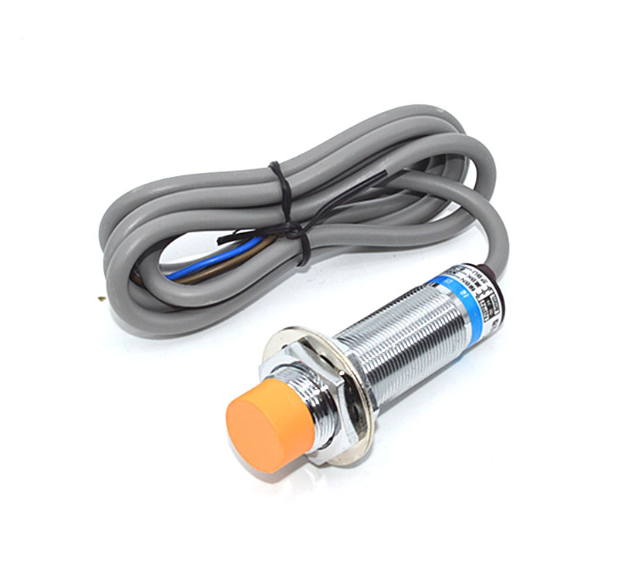
4.PROXIMITY SENSOR
It is an electronic sensor that can detect the presence of objects within its vicinity without any actual physical contact.
The object being sensed is often referred to as the proximity sensors target.

Slide 12
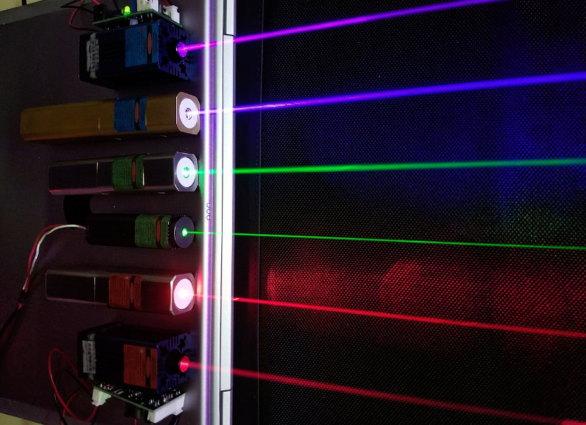
5. LASER LIGHT
A laser is a device that emits light through a process of optical amplification based on the stimulated emission of electromagnetic radiation.
The term "laser" originated as an acronym for "Light Amplification by Stimulated Emission of Radiation".

Slide 13
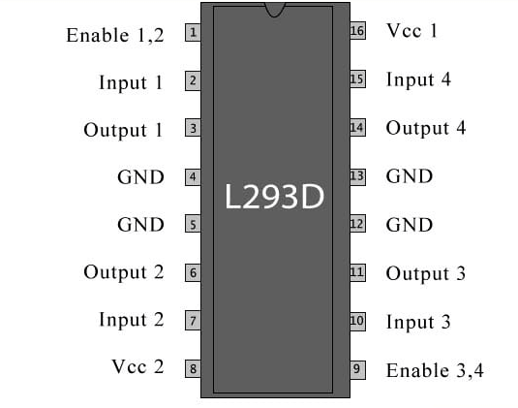
6.L293D MOTOR DRIVER
L293D contains two inbuilt H-bridge driver circuits.
In its common mode of operation, two DC motors can be driven simultaneously, both in forward and reverse direction.
The motor operations of two motors can be controlled by input logic at pins 2 & 7 and 10 & 15. Input logic 00 or 11 will stop the corresponding motor.
Logic 01 and 10 will rotate it in clockwise and anticlockwise direction, respectively

Slide 14
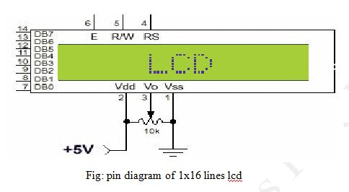
7.LCD DISPLAY
A program must interact with the outside world using input and output devices that communicate directly with a human being.
One of the most common devices attached to a controller is an LCD display. Some of the most common LCDs connected to the controllers are 16X1, 16x2 and 20x2 displays.

Slide 15
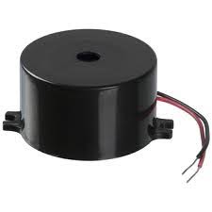
8.BUZZER
A buzzer or beeper is a signaling device, usually electronic, typically used in automobiles, household appliances such as a microwave oven, or game shows.

Slide 16
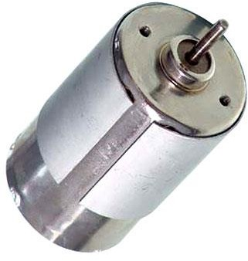
9.DC MOTOR
The DC motor has two basic parts: the rotating part that is called the armature and the stationary part that includes coils of wire called the field coils. The stationary part is also called the stator.

Slide 17
6. APPLICATIONS
Military purpose
Automobiles
Industries

Slide 18
7. ADVANTAGES
Capability Increase, Force Multiplier.
Risk Reduction.
Situation Awareness and Intelligence Gathering.
Consistency.
Efficiency and Productivity Increase.

Slide 19
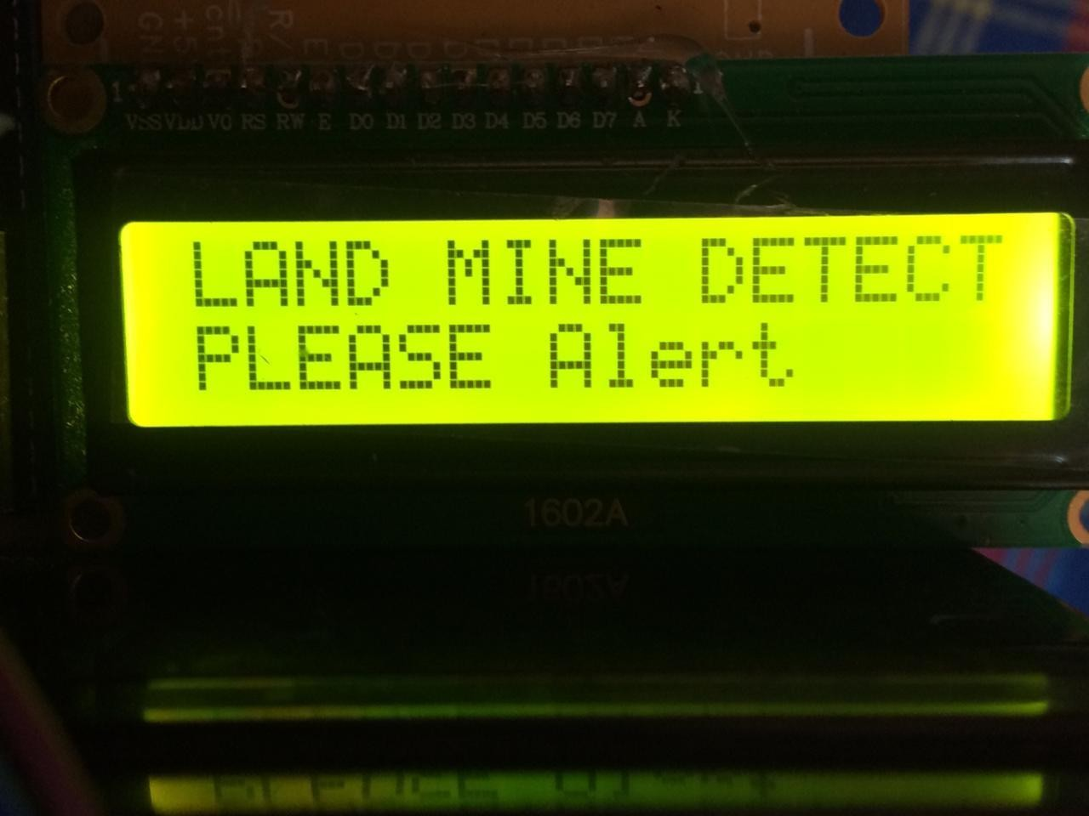
8. RESULT
The robot prototype executes successfully and it detects the obstacle, smoke, landmine like metal bodies and it changes its direction into safe position.

Slide 20
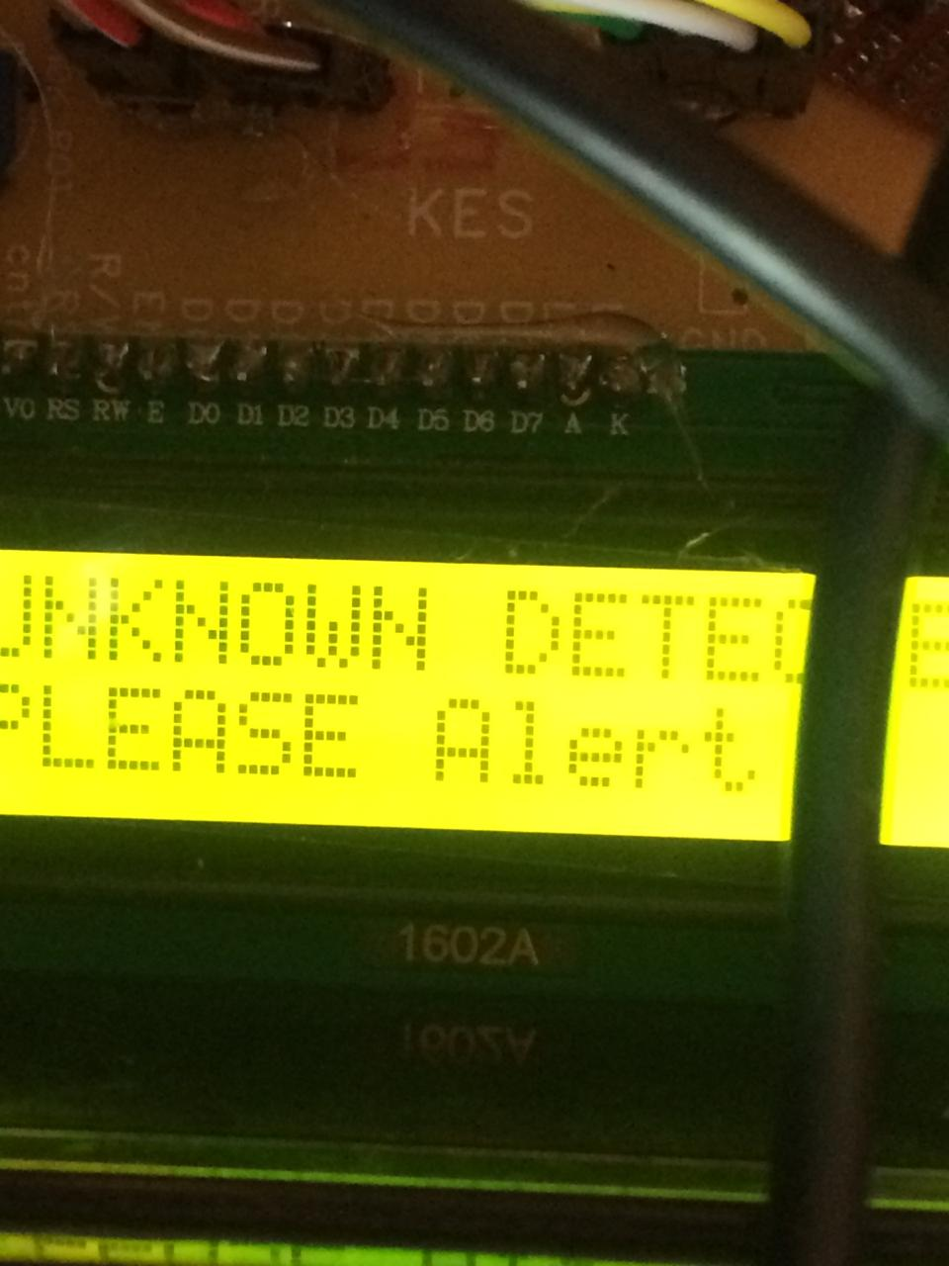
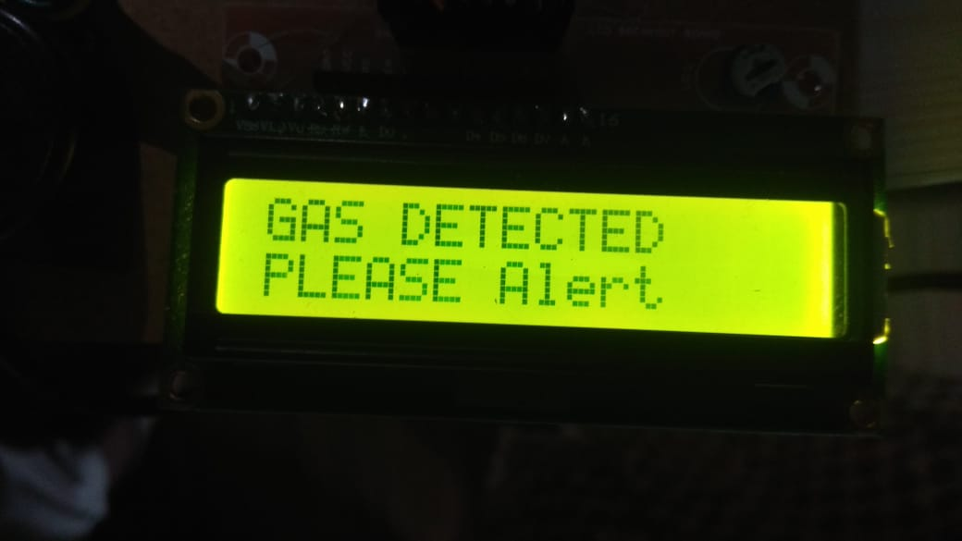
Cont…

Slide 21
9.CONCLUSION
Here the circuit is designed in such a way that whenever the infrared signal is interrupted ,logic high signal is generated and fed to arduino on receipt of this signal, laser light will fall on the obstacle similarly when metal is detected and gas is sensed LCD will display landmine detected and buzzer will energize and gives a beep sound respectively

Slide 22
10. FUTURE SCOPE
It is used in intelligent enemy detection and can also used for land mine detection oil and gas industries in order to avoid from dangerous hazards Military application it is used for fighting with enemies using powerful laser.

Slide 23
THANK YOU
ANY QUESTIONS??

